Slide 1
Java Programming
Lecture No:-16

Slide 2
Agenda
Java Database Connectivity (JDBC) architecture
Types of drivers, java.sql package
Establishing connectivity and working with connection interface,
Working with statement, PreparedStatement, CallableStatement interface,
Working with ResultSet interface, methods and fields
Resulset types, working with ResultSetMetaData interface

Slide 3
Connects to
Java Application Database
The below given figure shows the Employee Logging System application developed in Java interacting with the Employee database using the JDBC API:
Employee Logging System
RDBMS
EmpName
JDBC API
EmployeeLog
E-Mail Address
Name | Email

Slide 4
JDBC Architecture
It can be categorized into into two layers:
JDBC Application Layer
JDBC Driver Layer
Driver
Oracle
Java
Application
JDBC
API
DB2
Driver
Driver
SQL Server

Slide 5
JDBC Architecture (Continued)
Application
JDBC
Driver
Java code calls JDBC library
JDBC loads a driver
Driver talks to a particular database
Can have more than one driver -> more than one database

Slide 6
JDBC Drivers
JDBC-ODBC Bridge Driver
Type I: “Bridge” -
Type II: “Native” -
Type III: “Middleware” -
Type IV: “Pure” -
Native-API Partly-Java Driver
JDBC-Net Pure-Java Driver
Native Protocol Pure-Java Driver
Overview of All Drivers

Slide 7
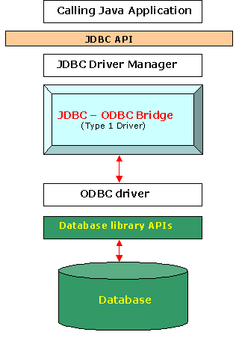
Type I Drivers
Use bridging technology
Translates query obtained by JDBC into corresponding ODBC query, which is then handled by the ODBC(Open DataBase Connectivity) driver.
Almost any database for which ODBC driver is installed, can be accessed.

Slide 8
Disadvantage of Type-I Driver
Performance overhead since the calls have to go through the JDBC overhead bridge to the ODBC driver, then to the native db connectivity interface.
The ODBC driver needs to be installed on the client machine.
Not good for Web

Slide 9
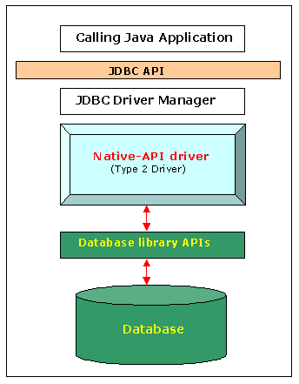
Type II Drivers
Native API drivers
Better performance than Type 1 since no jdbc to odbc translation is needed.
Converts JDBC calls into calls to the client API for that database.

Slide 10
Disadvantage of Type-II Driver
The vendor client library needs to be installed on the client machine.
Cannot be used in internet due the client side software needed.
The driver is compiled for use with the particular operating system.
Mostly obsolete now
Not good for Web

Slide 11
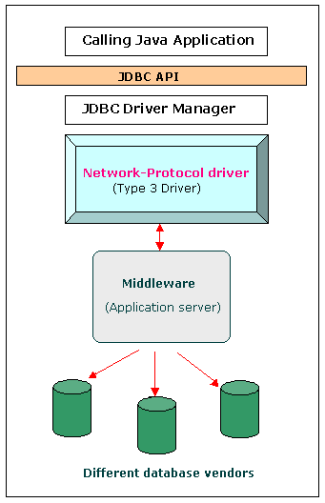
Type III Drivers
Follows a three tier communication approach.
Calls middleware server, usually on database host
Very flexible -allows access to multiple databases using one driver
Only need to download one driver

Slide 12
Disadvantage of Type-III Driver
Requires database-specific coding to be done in the middle tier.
An extra layer added may result in a time-bottleneck.

Slide 13
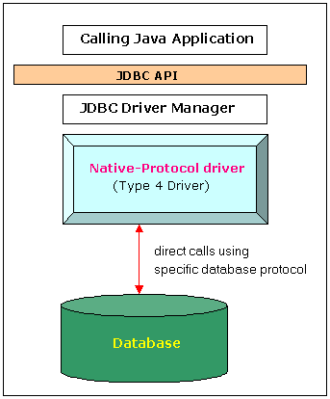
Type IV Drivers
100% Pure Java
Communicate directly with a vendor’s database through socket connection
Use Java networking libraries to talk directly to database engines
e.g include the widely used Oracle thin driver - oracle.jdbc.driver. OracleDriver

Slide 14
Disadvantage of Type-IV Driver
At client side, a separate driver is needed for each database

Slide 15
JDBC Drivers (Fig.)
JDBC
Type I
“Bridge”
JDBC
ODBC
Driver
Type II
“Native”
CLI (.lib)
Type III
“Middleware”
Middleware
Server
Type IV
“Pure”

Slide 16
JDBC API
The JDBC API classes and interfaces are available in the java.sql and the javax.sql packages.
The commonly used classes and interfaces in the JDBC API are:
DriverManager class: Loads the driver for a database.
Driver interface: Represents a database driver. All JDBC driver classes must implement the Driver interface.
Connection interface: Enables you to establish a connection between a Java application and a database.

Slide 17
JDBC API (Continued)
Statement interface: Enables you to execute SQL statements.
ResultSet interface: Represents the information retrieved from a database.
SQLException class: Provides information about the exceptions that occur while interacting with databases.

Slide 18
Steps to create JDBC Application
DriverManager
Driver
Connection
Statement
ResultSet

Slide 19
Steps to create JDBC Application (Continued)
Load A Driver
Connect to a Database
Create and execute SQL statements
Handle SQL Exception

Slide 20
JDBC API (Continued)
Load A Driver
Loading a Driver can be done in two ways:
Programmatically:
Using the forName() method
Using the registerDriver()method

Slide 21
JDBC API (Continued)
Load A Driver (Programmatically)
Using the forName() method
The forName() method is available in the java.lang.Class class.
The forName() method loads the JDBC driver and registers the driver with the driver manager.
The method call to use the the forName() method is:
Class.forName("sun.jdbc.odbc.JdbcOdbcDriver");

Slide 22
JDBC API (Continued)
Load A Driver (Programmatically)
Using the registerDriver() method
You can create an instance of the Driver class to load a JDBC driver.
This instance provide the name of the driver class at run time.
The statement to create an instance of the Driver class is:
Driver d = new sun.jdbc.odbc.JdbcOdbcDriver();
You need to call the registerDriver() method to register the Driver object with the DriverManager.
The method call to register the JDBC-ODBC Bridge driver is:
DriverManager.registerDriver(d);

Slide 23
JDBC API (Continued)
Connect to a Database
Connecting to a Database Using DriverManager.getConnection() method:
Connection getConnection (String <url>)
Connection getConnection (String <url>, String <username>, String <password>)
Connects to given JDBC URL.
throws java.sql.SQLException
Returns a connection object.
Example:
Connection con = DriverManager.getConnection(“jdbc:odbc:MyDSN”,”username”,”password”);

Slide 24
JDBC API (Continued)
Create and Execute SQL Statements
The Connection object provides the createStatement() method to create a Statement object.
Statement createStatement()
returns a new Statement object
PreparedStatement prepareStatement(String sql)
returns a new PreparedStatement object
CallableStatement prepareCall(String sql)
returns a new CallableStatement object

Slide 25
import java.sql.*; /step 1
class ReadFromAccess {
public static void main(String args[]) throws Exception {
// step 2
Class.forName("sun.jdbc.odbc.JdbcOdbcDriver");
//DriverManager.registerDriver(new sun.jdbc.odbc.JdbcOdbcDriver());
// step 3
Connection con = DriverManager.getConnection("jdbc:odbc:mydsn");
// step 4
Statement stmt = con.createStatement();
// step 5
ResultSet rs = stmt.executeQuery("select * from empinfo");
// step 6
while(rs.next()) {
System.out.print(rs.getString("empno"));
System.out.println("\t" + rs.getString("ename"));
}
rs.close(); stmt.close();con.close();}} // step 7

Slide 26
JDBC API (Continued)
Statement Interface
A Statement object is used for executing a static SQL statement and obtaining the results produced by it.

Slide 27
JDBC API (Continued)
Statement Interface Methods
ResultSet executeQuery(String)
Execute a SQL statement that returns a single ResultSet.
int executeUpdate(String)
Execute a SQL INSERT, UPDATE or DELETE statement. Returns the number of rows changed.
boolean execute(String)
Execute a SQL statement that may return multiple results.

Slide 28
Methods in java.sql.statement to Execute SQL Statements
SQL statement | JDBC statement to use | Return Type | Comment
SELECT | executeQuery(String sql) | ResultSet | The return value will hold the data extracted from the database.
INSERT, UPDATE, DELETE, CREATE, DROP | executeUpdate(String sql) | int | The return value will give the count of the number of rows changed , or zero otherwise.
Stored procedure with multiple results | execute(String sql) | boolean | The return value is true if the first result is a ResultSet, false otherwise.

Slide 29
JDBC Statements
A JDBC statement object is used to send your SQL statement to the database server
A JDBC statement is associated with an open connection and not any single SQL statement
JDBC provides three classes of SQL statement
Statement
PreparedStatement
CallableStatement

Slide 30
Creating JDBC Statement
Statement stmt = con.createStatement();
String createCS4400 = “Create table CS4400 “+
“(SSN Integer not null, Name VARCHAR(32), “+ “Marks Integer)”;
stmt.executeUpdate(createCS4400)
String insertCS4400 = “Insert into CS4400 values “+
“(123456789,abc,100)”;
stmt.executeUpdate(insertCS4400);

Slide 31
JDBC API (Continued)
PreparedStatement Interface
The PreparedStatement Interface object:
pass runtime parameters to the SQL statements.
Is compiled and prepared only once by the JDBC.
prepareStatement() method is used to submit parameterized query using a connection object to the database.

Slide 32
JDBC API (Continued)
PreparedStatement Interface (Continued)
Code snippet for preparedStatement:
The value of each ‘?’ is set by calling appropriate setXXX() method, In this case setInt()
The code snippet to pass the employee id during runtime using prepareStatement() method:
String s=“select * from employee where eid=? “
PreparedStatement pst = con.prepareStatement(s);
pst.setInt(1,100 );
ResultSet rs=pst.executeQuery();
It acts as a placeholder

Slide 33
Prepared Statement (cont..)
Executing Select Statement
e.g
String query =“SELECT Name from CS4400 where SSN=?”;
PreparedStatement stmt2 = con.prepareStatement(query);
Stmt2.setInt(1,SSN);
ResultSet rs = stmt2.executeUpdate();
While (rs.next())
System.out.println(rs.getString(Name);

Slide 34
JDBC(stored procedure)
CREATE OR REPLACE PROCEDURE sp_interest
( id IN INTEGER bal IN OUT FLOAT ) AS
BEGIN
SELECT balance INTO bal FROM accounts WHERE account_id = id ;
bal := bal + bal * 0.03 ;
UPDATE accounts
SET balance = bal
WHERE account_id = id ;
END;

Slide 35
JDBC(stored procedure) Cont..
CallableStatement cstmt =
con.prepareCall( “{ call sp_interest(?,?)} ”);
cstmt.setInt(1,46);
cstmt.setFloat(2, 5888.86);
cstmt.registerOutParameter(2,Types.FLOAT);
cstmt.execute();
System.out.println(cstmt.getFloat(2));

Slide 36
JDBC API (Continued)
Database Operations
Querying a table
Inserting rows
Updating rows
Deleting rows

Slide 37
JDBC API (Continued)
SQL Syntax
INSERT INTO table ( field1, field2 ) VALUES ( value1, value2 )
inserts a new record into the named table
UPDATE table SET ( field1 = value1, field2 = value2 ) WHERE condition
changes an existing record or records
DELETE FROM table WHERE condition
removes all records that match condition
SELECT field1, field2 FROM table WHERE condition
retrieves all records that match condition

Slide 38
JDBC API (Continued)
Database Operations
Querying a table
The code snippet to retrieve data from
the employees table is:
String semp = "SELECT * FROM employees";
Statement stmt = con.createStatement();
ResultSet rs = stmt.executeQuery(semp);

Slide 39
JDBC API (Continued)
Database Operations
Inserting rows
The code snippet to insert rows in employees table is:
String semp = “INSERT INTO employees(eid, ename,
basic) VALUES(1,’A.Sinha’,28000)”;
Statement stmt = con.createStatement();
int noOfInsert = stmt.executeUpdate(semp);

Slide 40
JDBC API (Continued)
Database Operations
Updating rows
The code snippet to insert rows in employees table is:
String semp = “UPDATE employees SET
basic=basic+2000 where eid=1”;
Statement stmt = con.createStatement();
int noOfUpdate = stmt.executeUpdate(semp);

Slide 41
JDBC API (Continued)
Database Operations
Deleting rows
The code snippet to delete rows in employees table is:
String semp = “DELETE FROM employees WHERE
eid=1”;
Statement stmt = con.createStatement();
int noOfDelete = stmt.executeUpdate(semp);

Slide 42
JDBC API (Continued)
DDL Operations
Creating Table
Altering Table
Dropping Table

Slide 43
JDBC API (Continued)
DDL Operations
Creating Table
The code snippet to create a department table is:
Statement stmt = con.createStatement();
stmt.execute(“create table department(eid number(5),
deptno char(10), deptname varchar2(20)” );

Slide 44
JDBC API (Continued)
DDL Operations
Altering Table
The code snippet to add a column in department
table is:
Statement stmt = con.createStatement();
stmt.execute(“ALTER TABLE department add depthead
varchar2(15)”);

Slide 45
JDBC API (Continued)
DDL Operations
Dropping Table
The code snippet to create a department table is:
Statement stmt = con.createStatement();
stmt.execute(“DROP TABLE department” );

Slide 46
JDBC API (Continued)
ResultSet Interface
A ResultSet provides access to a table of data generated by executing a Statement.
Only one ResultSet per Statement can be open at once.
The table rows are retrieved in sequence.
A ResultSet maintains a cursor pointing to its current row of data.
The 'next' method moves the cursor to the next row.

Slide 47
JDBC API (Continued)
ResultSet Methods
boolean next()
activates the next row
the first call to next() activates the first row
returns false if there are no more rows
void close()
disposes of the ResultSet
allows you to re-use the Statement that created it

Slide 48
JDBC API (Continued)
ResultSet Methods (Continued)
Type getType(int columnIndex)
returns the given field as the given type
fields indexed starting at 1 (not 0)
Type getType(String columnName)
same, but uses name of field
less efficient
int findColumn(String columnName)
looks up column index given column name

Slide 49
JDBC API (Continued)
ResultSet Methods (Continued)
String getString(int columnIndex)
boolean getBoolean(int columnIndex)
byte getByte(int columnIndex)
short getShort(int columnIndex)
int getInt(int columnIndex)
long getLong(int columnIndex)
float getFloat(int columnIndex)
double getDouble(int columnIndex)
Date getDate(int columnIndex)
Time getTime(int columnIndex)
Timestamp getTimestamp(int columnIndex)

Slide 50
JDBC API (Continued)
ResultSet Methods (Continued)
boolean first()
boolean isFirst()
boolean beforeFirst()
boolean isbeforeFirst()
Shifts the control of a result set cursor to the first row of the result set.
checks whether result set cursor points to the first row or not.
moves the cursor before the first row.
Checks whether result set cursor moves before the first row.
Method Name
Description

Slide 51
JDBC API (Continued)
ResultSet Methods (Continued)
boolean last()
boolean isLast()
boolean afterLast()
boolean isAfterLast()
Shifts the control to the last row of result set cursor.
checks whether result set cursor points to the last row or not.
moves the cursor after the last row.
Checks whether result set cursor moves after the last row.
Method Name
Description

Slide 52
JDBC API (Continued)
ResultSet Methods (Continued)
boolean next()
boolean previous()
boolean absolute(int rowno)
boolean relative(int rowno)
Shifts the control to the next row of result set.
Shifts the control to the previous row of the result set.
Shifts the cursor to the row number that you specify as an argument.
Shifts the cursor relative to the row number that you specify as an argument.
Method Name
Description

Slide 53
JDBC API (Continued)
ResultSet Methods (Continued)
void insertRow()
void deleteRow()
void updateRow()
Inserts a row in the current result set.
Deletes a row in the current result set.
Updates a row of the current resultset.
Method Name
Description

Slide 54
JDBC API (Continued)
ResultSet Methods (Continued)
void updateString(col name, String s)
void updateInt(col name, int x)
void updateFloat()
void cancelRowUpdates()
Updates the specified column name with the given string value.
Updates the specified column name with the given int value.
Updates the specified column name with the given float value.
Cancels all of the updates in a row.
Method Name
Description

Slide 55
JDBC API (Continued)
ResultSet Fields
TYPE_FORWARD_ONLY
TYPE_SCROLL_SENSITIVE
TYPE_SCROLL_INSENSITIVE
The cursor can only move forward in the result set.
The cursor can scroll forward and backward, and the result set is not sensitive to changes made by others to the database that occur after the result set was created.
The cursor can scroll forward and backward, and the result set is sensitive to changes made by others to the database that occur after the result set was created.
Field Name
Description

Slide 56
JDBC API (Continued)
ResultSet Fields
CONCUR_READ_ONLY
CONCUR_UPDATABLE
Does not allow to update the ResultSet object.
Allows to update the ResultSet object .
Field Name
Description

Slide 57
Resultset attributes
Statement stmt = con.createStatement(
ResultSet.TYPE_SCROLL_INSENSITIVE,
ResultSet.CONCUR_READ_ONLY);
ResultSet srs = stmt.executeQuery("SELECT COF_NAME, PRICE FROM COFFEES");
The first new argument must be one of the 3 constants added to the ResultSet interface to indicate the type of a ResultSet object: TYPE_FORWARD_ONLY, TYPE_SCROLL_INSENSITIVE, or TYPE_SCROLL_SENSITIVE.
The second new argument must be one of the two ResultSet constants for specifying whether a result set is read-only or updatable: CONCUR_READ_ONLY or CONCUR_UPDATABLE

Slide 58
Moving the Cursor Backward
Statement stmt = con.createStatement(
ResultSet.TYPE_SCROLL_INSENSITIVE,
ResultSet.CONCUR_READ_ONLY);
ResultSet srs = stmt.executeQuery(
"SELECT COF_NAME, PRICE FROM COFFEES");
srs.afterLast();
while (srs.previous()) {
String name = srs.getString("COF_NAME");
float price = srs.getFloat("PRICE");
System.out.println(name + " " + price);
}

Slide 59
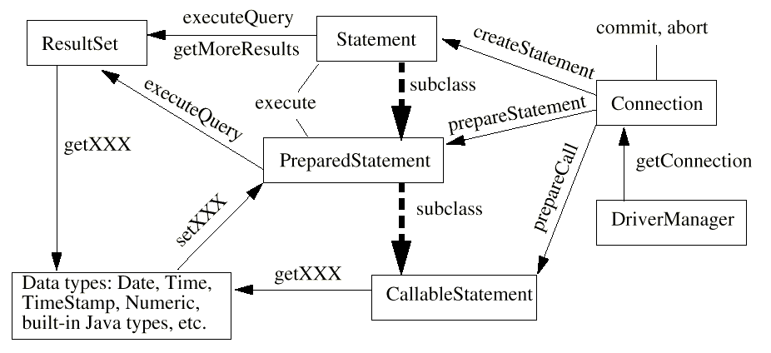
JDBC Class Diagram

Slide 60
THANK YOU

